Slide 1
I Like To
Move It,
Move It
Road to Teaching 2016
Dr. Mary Funaoka

Slide 2
Strategies to Get Students Walking & Talking
Block Party
Mix-Freeze-Pair
Microlabs
Four Corners
Labeling

Slide 3
Block Party
Why:
Gives students an opportunity to randomly group, reflect upon, and discuss text.

Slide 4
Block Party
Read and reflect on your quote.
Join a party with 4 different colors.
Each read your quote and share your response.

Slide 5
Mix-Freeze-Pair
Why:
Gives students an opportunity to randomly group and discuss a topic in pairs.

Slide 6
Mix-Freeze-Pair
MIX around the room.
FREEZE when the music stops.
PAIR up and answer the question on the screen.

Slide 7
Mix-Freeze-Pair
What is your definition of diversity? What do you feel is (would be) challenging and rewarding about teaching in a diverse school setting?

Slide 8
Mix-Freeze-Pair
Describe a time you encountered conflict with a person from a different background than yours. How did you handle the situation?

Slide 9
Microlabs
Why:
to democratize participation while addressing a specific content topic
to promote reflection and active listening
affirm individual ideas and withhold judgment

Slide 10
Microlabs
1. Form groups of 4: assign A, B, C, D
2. Five minutes/round:
Listen to the question
Silently reflect for 60 seconds
A responds for 60 seconds*
B responds for 60 seconds*
C responds for 60 seconds*
D responds for 60 seconds*
*sit with the silence, if time is leftover

Slide 11
Microlabs
Round 1:
Describe a time you have experienced an “ism” (racism, sexism, classism, ableism, ageism). What was it like and how did you feel?

Slide 12
Microlabs
Round 2:
How do you encourage people to honor the uniqueness of each individual? How do you (would you) challenge stereotypes and promote sensitivity and inclusion?

Slide 13
Four Corners
Why:
Gives students an opportunity to share their opinion about a topic both physically and verbally.

Slide 14
Four Corners
Listen to each statement.
Move to the corner that represents your belief.
With those in your corner, share your reasons why.

Slide 15
Four Corners
All students should be treated the SAME EXACT WAY.

Slide 16
Four Corners
Our goal as teachers is to shape the values and beliefs of our students.

Slide 17
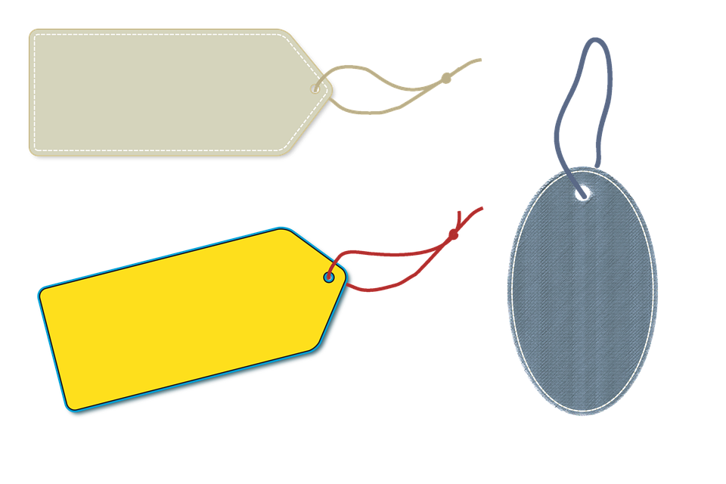
Labeling
Why:
An opportunity to reflect on “labels” we assign others

Slide 18
Labeling
Place your label on your forehead
Read the different labels around the room
Form a group of 3 that you would best get along with

Slide 19
Labeling
Group discussion: Why did the 3 of you choose each other?
Class discussion: How does this connect to real classroom experiences?

Slide 20
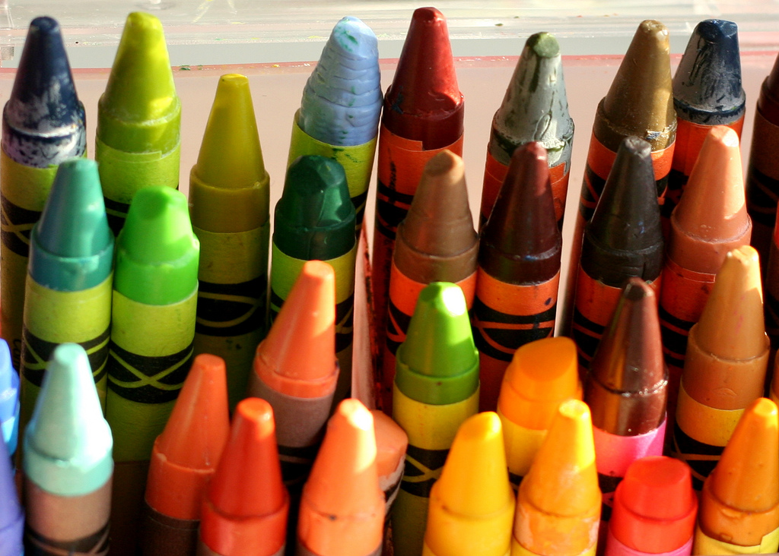
“Crayons” -Author Unknown
We could learn a lot from crayons:
Some are sharp,
Some are pretty,
Some are dull,
Some have weird names,
and are all different colors,
But they all have to live in the same box.

